Slide 1

2022

Slide 2




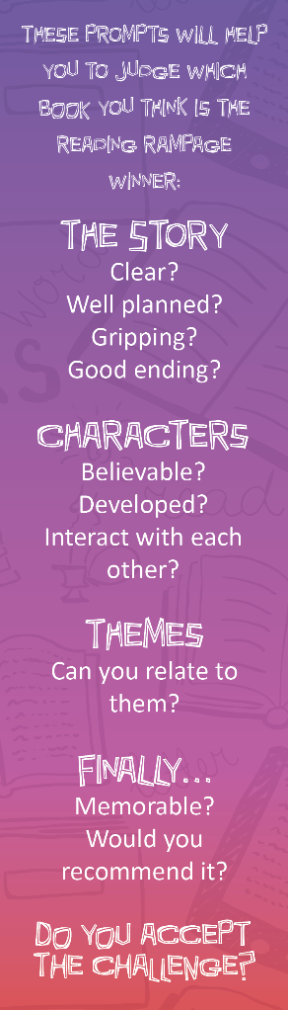

Slide 3




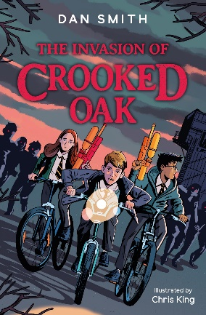








Slide 4


@reading_rampage
#ReadingRampage2022
www.readingrampage.org.uk

