Slide 1

School Launch Presentation 2024

Slide 2
What is Reading Rampage?
Reading Rampage gives you an amazing opportunity to take part in a reading challenge especially designed for secondary students.
The project runs from January to end of May 2024 and aims to inspire and motivate you in, Year 7 and 8, to be active and enthusiastic reader who read by choice for pleasure. Along the way, we will be introducing you to some great books and authors. You may even meet them ‘virtually’ in one of our live online school sessions in the next few months.
The book judged to be most borrowed and the book judged to be the most highly rated by participating students will be announced at a special online awards event in June 2024.
This year 22 schools from Leicester, Leicestershire and Derby are taking part. That’s a lot of students reading our amazing collection of books!

Slide 3

This year’s shortlist

Slide 4

Launch Video
Notes:
https://youtu.be/C06HdC8ffIw

Slide 5


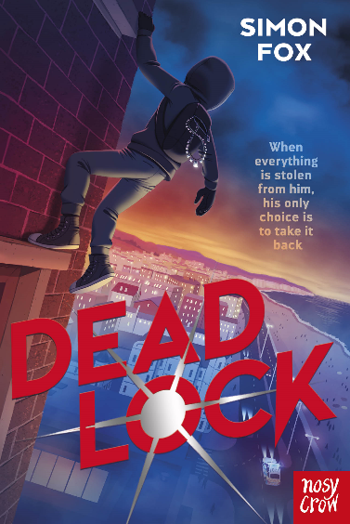
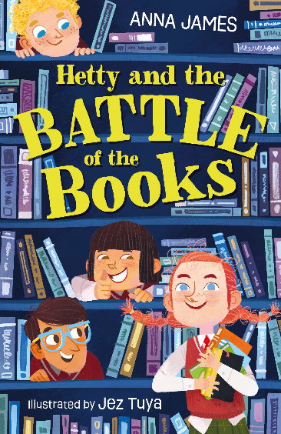


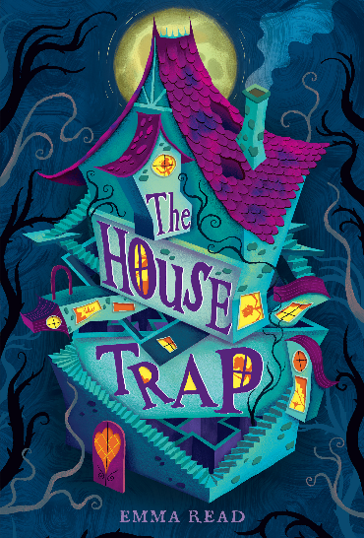



Book talking

Slide 6

Glow Up, Lara Bloom
by Dee Benson

Slide 7

Kofi and the Rap Battle Summer
By Jeffrey Boakye

Slide 8

Deadlock
by Simon Fox

Slide 9

Hetty and the Battle
of the Books
by Anna James

Slide 10

Finn Jones Was Here
by Simon James Green

Slide 11
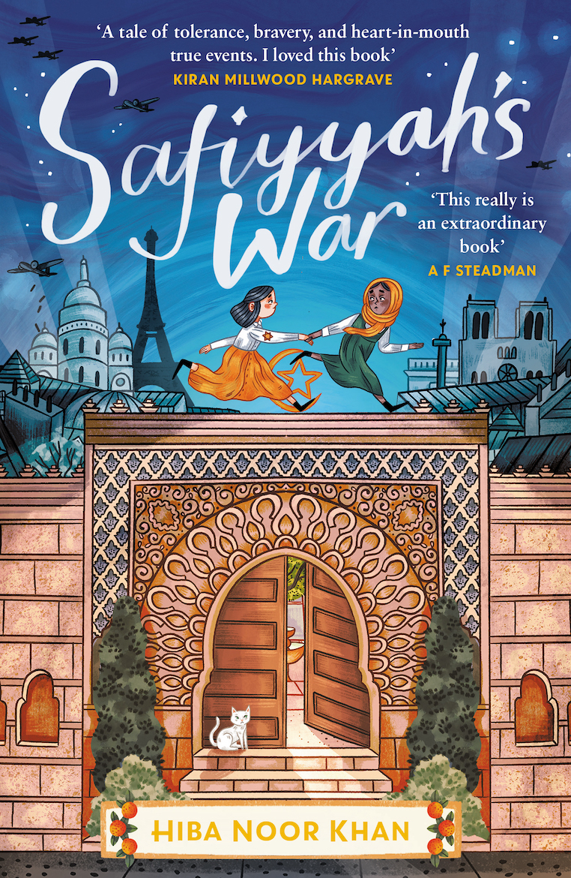
Safiyyah’s War
by Hiba Noor Khan

Slide 12

The House Trap
by Emma Read

Slide 13

The Piano at the Station
by Helen Rutter

Slide 14

Bite Risk
by S. J. Wills

Slide 15

Bad Influence
by Tamsin Winter

Slide 16
What do I need to do?
Students are challenged to read as many of the 10 different titles as possible between January and the end of May, discussing these with your school friends and the staff involved in Reading Rampage in your school. You may read these in class or independently, in school or at home.
We ask you then to give each book you read your own star rating based on the judging criteria checklist.
The author of the most highly rated book will receive the prestigious Reading Rampage Award at a special celebration event in June. The book most borrowed will be awarded a certificate .
One lucky student will be nominated by their school for their commitment to Reading Rampage and will receive a special prize and commendation at the award celebration.

Slide 17
How do I get involved?
Template slide for schools to outline how students can get involved or when/how they will be reading the books

Slide 18
Activities linked to The books
There are a range of activities and challenges which have been created for your teachers and librarians to use with you in school linked to each title.
The members of staff co-ordinating this year’s Reading Rampage will share these with you.
These include:
Group activities and competitions
Ideas and notes for reading groups on each book
Word searches
Our weekly challenges
Your own Reading Rampage Booklet to keep track of what you have read
…… and much more

Slide 19

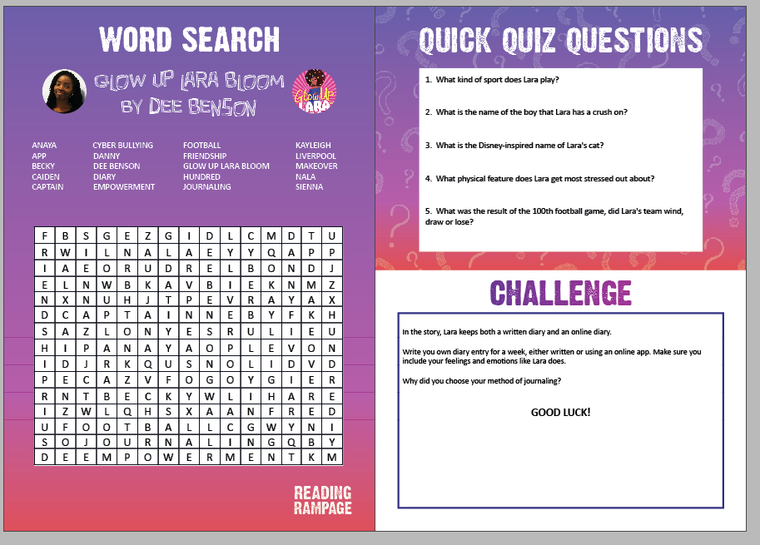
Book Resources

Slide 20
School activities
Template slide - specific school based activities can be inserted here

Slide 21
Virtual Author visits
Back by popular demand… our live online virtual author visits
To give you the opportunity to meet the authors of our Reading Rampage books online
1 hour live session for each author in March and May 2024
Watch with your class or book group and your teachers
Hear about the author and their shortlisted book
Submit questions before the session to have answered by the author

Slide 22

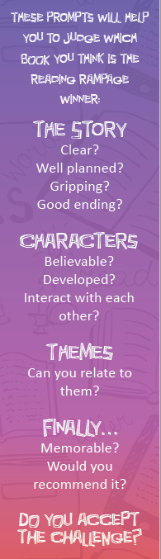
Voting for Your top book
As Reading Rampage is a book award, there has to be a winner!
Students can track their reading and rate the books.
We will be asking schools to nominate the winner from their school. There are two categories:
1. Highest ranking book – favourite read based on judging criteria (prompts on your Reading Rampage book mark).
2. Most borrowed book – most popular read book based on how many people have borrowed the book.

Slide 23
award celebration event
Once the votes have been counted and the winners of Reading Rampage 2024 have been decided, you will be invited to join an online awards ceremony in June with your class, teachers and all of the other schools taking part this year – our shortlisted authors may even be there too! We will announce the winners and talk a bit about what schools have been getting up to with Reading Rampage this year.
Schools will also be asked to nominate a student for an award. Teachers will be asked to tell us why the student has been nominated. The nominated student will receive a £10 book voucher and a certificate.

Slide 24

What to do next?
Are you intrigued?
Will you take up the challenge?
Please speak to XXXX to find out how to get involved.
Notes:
Insert Reading Rampage lead name

Slide 25
Let us know what you are doing via twitter
@readingrampage_
#ReadingRampage2024
@LeicesterWiT
@leicesterlibrar
@MidlandsCLS

Slide 26
Check out our Website
Website:
www.readingrampage.org.uk

