Slide 1

2024

Slide 2

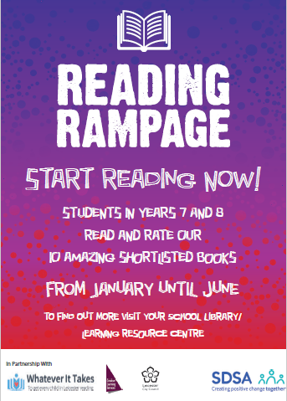


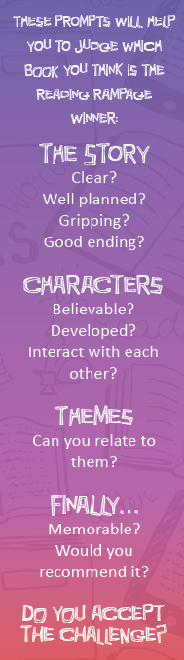

Slide 3












Slide 4


@readingrampage_
#ReadingRampage2024
www.readingrampage.org.uk

